Slide 1
Malla Reddy College Of Engineering
Problem statement Title:
Team Name: Team Leader: Institute Code: Institute Name:
Develop Safety tools that works without internet connectivity
PRG
P.Lokeshwar Q9
Malla Reddy College of Engineering

Slide 2







Idea/Approach Details
L. Mental Health and support system
Support systems include friends, family, and community resources that help individuals cope with mental health challenges. These networks can provide emotional support, practical help, and a sense of belonging, which are essential for recovery and maintaining mental wellness.
Personal Support
Counselors :
Provide tools and strategies to address mental health challenges

Slide 3
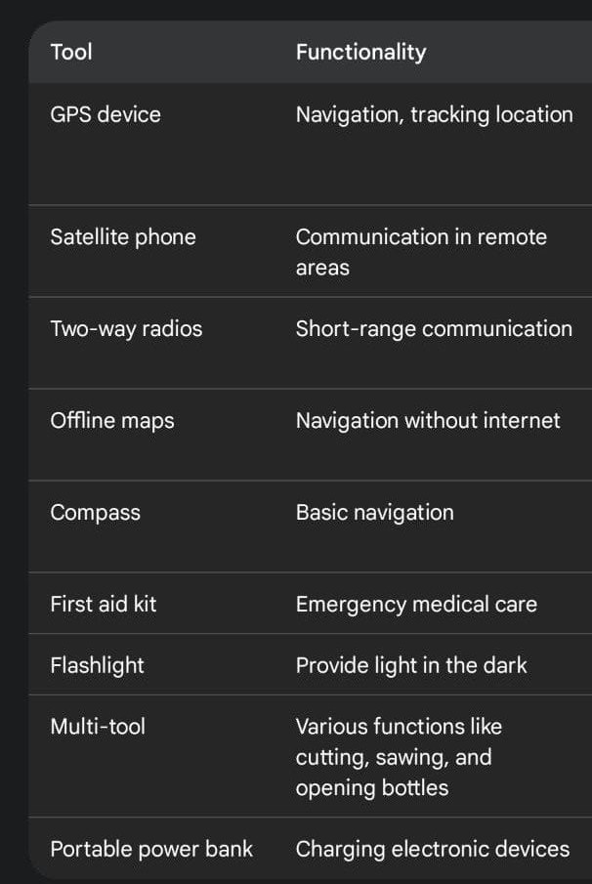
Tools That Require without Internet
If we are not using the internet how can we connect to other by GPS
Communication we can communicate with othere
For example in train apps they show us GPS use only in trains because it shows our location

Slide 4
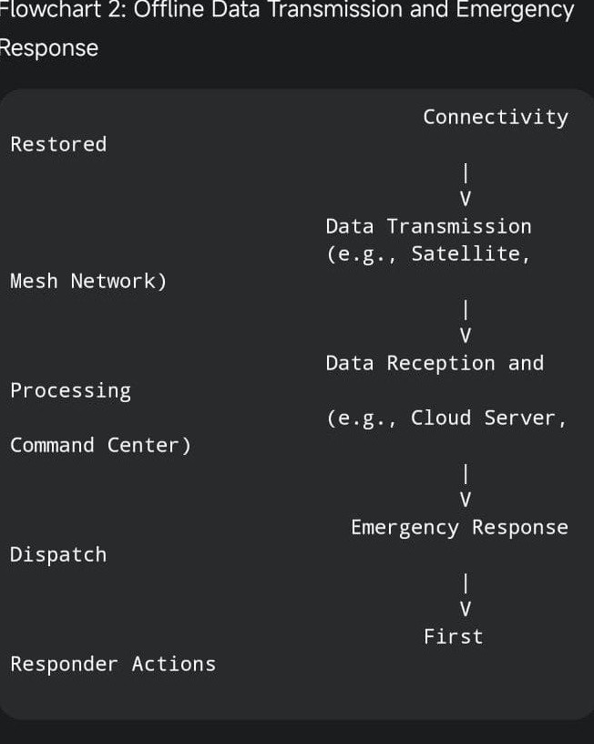
Flow charts
The data that Represents the connectivity Connectivity Restored
—->
Data Transmission Network
——>
Data Reception and processing
—->
Emergency Response Dispatch
i

Slide 5
Safety Device with GPS Tracking & Alerts

Slide 6
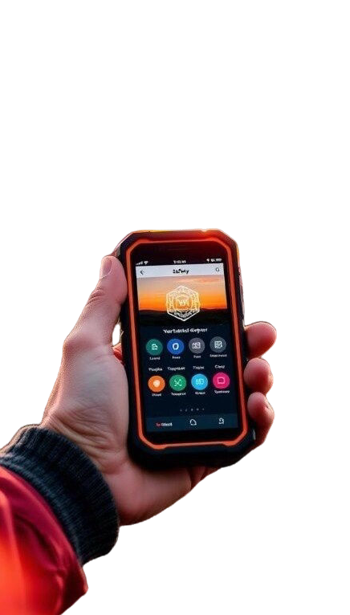
Ofﬂine Navigation
Equip personnel with ofﬂine mapping Applications and GPS systems for location tracking and navigation in areas without internet access
Offiine Communication
Utilize ofﬂine communication methods,such as two ways radios,Satellite Phones or ofﬂine messaging apps

Slide 7
Team Members Details
Team Leader Name : P.Lokeshwar
Team Number 1 : M.Vamshi Chaitanya Team Number 2 : B.Sai Rohith
Branch : CSE-DS
Thank You

